Slide 1

Cash and Working Capital Management
Guidance on PE – Pre-Deal Assessment
The full scope of Cash and Working Capital Management (CWCM) services is not permissible for SEC audit clients and their affiliates or IFAC PIE audit clients and their related parties. CWCM services are generally permissible for IFAC non-PIE audit clients subject to evaluating engagement circumstances using the conceptual framework (i.e. threats and safeguards approach) and provided we do not assume a management responsibility as outlined in the Global Quality & Risk Management Manual Chapter 11. See detailed guidance regarding Independence on slides 11-16 of the CWCM methodology guide.
RESTRUCTURING
Guidance
August 2008
ADVISORY
For the purpose of this document, all references to KPMG International, a Swiss cooperative that serves as a coordinating entity for a network of independent member firms operating under the KPMG name, will be referenced as KPMG International. Throughout this document, "KPMG" ["we," "our," and "us"] refers to the local, independent KPMG member firm or firms. Throughout this document “client” [“they,” “their and “them”] refers to the local, independent member firm’s client. KPMG International provides no client services.

Slide 2
Methodology Guidance for Pre-Deal Evaluation Engagements
  Please note the following guidance on scope of services:
  Pre-deal evaluation projects must be led by Transaction Services, due to the firm’s requirements around client and engagement acceptance for the pre-deal phase of a transaction, which are outlined in the Global TS Manual (see link provided below).
  http://www.aro.kworld.kpmg.com/NXT/gateway.dll?f=templates$fn=default.htm$VID=assursrc:all$id=UN_ITSMG_TSMG60$bpvid=yesN_ITSMG_TSMG60$bpvid=yes
  The Global TS Manual (Section 60) has specific policies and procedures that must be followed for evaluating prospective engagements relating to the pre-deal phase and addressing significant contractual matters, including integrity and objectivity, potential conflicts of interest, confidentiality, understanding client expectations, professional competence, engagement letters, scope modification (variation) letters, contingent fees, timing, and independence.
  The Global TS Manual (Section 110) also provides specific policies and guidance around written reporting in the pre-deal phase, including explaining the basis for information transmitted, not commenting (either verbally or in writing) regarding whether the proposed transaction should be completed, not provided any type of negative assurance, and report restrictions on publication or communication to parties other than those to whom the report is addressed, among other items.
  If the situation arises that a client has invited KPMG to conduct Finance Function Integration work in the Pre-Deal phase where TS has not been engaged, the engagement lead must consult their local Professional Practice Partner prior to accepting the engagement.
  The pre-deal assessment that focuses on Cash and Working Capital should be led by Restructuring

Slide 3
Index
Topics Covered Slide Number
Purpose of this document Slide 3
Approach to PE Pre-Deal Assessments Slide 4
Appendix One - Profit to Cash Conversion Calculation Slide 15
Appendix Two - Example Debtor Day Count Back Calculation Slide 16
Appendix Three - Illustrative benchmarking Slide 18
Appendix Four - Example good practice reporting and controls Slide 22

Slide 4
Purpose of this document
  Purpose
  The purpose of this document is to provide practitioners with an overview of our approach to Private Equity (PE) pre-deal assessment focused on cash and working capital.
  The document will illustrate a typical approach, together with information sources and example reporting templates which also can be found on the Microweb (Click here) .

Slide 5
Approach to PE Pre-Deal Assessments

Slide 6
PE pre-deal assessments
Overview and approach
Overview
  A pre-deal engagement usually arises as part of a Transaction Services due diligence (DD) engagement. In theory, this could be either buy or sell side.
  The main reason to become involved in these types of engagement is to identify possible opportunities for larger follow on engagements immediately post-deal.
  The benefits of this type of project include:
    Identifying the true cash generation potential of a business
    Assess the quality of visibility of and control over cash
    Identify hidden liquidity opportunities which may provide a competitive advantage to a PE house in the bidding process
    Increase the level of debt available to finance the deal if we can demonstrate greater levels of free cash flow or greater profit to cash conversion rates. An example profit to cash conversion calculation is attached as Appendix One.
  Typical engagement
  A typical engagement would be two to three days in duration with limited or no access to management. Often we provide a list of questions to TS who will obtain the answers on our behalf and feedback to us.
  Our output is usually a short report of two to five pages which can be used as a briefing paper for TS or included (in whole or modified) as part of a larger TS DD report.

Slide 7






PE pre-deal assessments
Overview and approach (cont.)
  Sources of information
  The main sources of information available for analysis on a pre-deal engagement include:
    Direct discussions with management (this is rare)
    Information from management provided via TS asking questions on our behalf
    Information contained within a data room (e.g. statutory accounts, management accounts, detailed management information such as stock reports, debtors ledgers)
    KPMG TS due diligence workings
    A vendor due diligence report
    Previous cash management engagements and our experience
KPMG’s approach focuses on our understanding of cash operating cycles overlaid with some specific sector knowledge
Assess historical and forecast working capital performance
Identify and quantify potential cash improvement opportunities
Illustrative benchmarking and good practice
High level reporting or input into Due Diligence Report
Assess current cash control and reporting environment
Identify shortfalls in to control and reporting against good practices

Slide 8






PE pre-deal approach
Assess cash and working capital performance
Assess historical and forecast working capital performance
Identify and quantify potential cash improvement opportunities
Illustrative benchmarking and good practice
High level reporting or input into Due Diligence Report
Assess current cash control and reporting environment
Identify shortfalls in to control and reporting against good practices
Potential cash improvement opportunities
  The key to this area is to use basic analytical skills in respect of the main working capital KPIs (debtor days, creditor days and stock turn/cover).
  TS will often spend a lot of time in their work calculating historical and forecast working capital levels. Whilst this can be a good indicator it should not be relied on exclusively and TS sometimes do not use count back type methods for calculating which can give rise to some misleading data. Where possible we should always use a count back methodology, albeit this will not always be possible when reviewing only publicly available data or a VDD report and so other methods of calculations, need to be considered. The key is to provide consistency of calculation.
  An example of a debtor countback is included as Appendix.
  If the information required to do a count back calculation is not available, other working capital calculations could include:
    (Trade debtors or creditors)/(sales or purchases) for a period multiplied by the number of days in the period
    Stock held as a percentage of historical sales levels
  Debtors and creditors figures can often be complicated or confused by including non-trade items and so these non-trade items should, where possible, be excluded when calculating debtor or creditor days.
  However, it may be important to understand items such as other debtors, prepayments, accruals, etc, as these may provide some scope for cash improvement.
  It is important to review information to identify anything that may be outside the course of normal business. These items can distort analysis, both positively and negatively. For example, seasonality is important in certain sectors (e.g. retail) and can affect working capital and cash balances throughout the year.
  The balance sheet should be scanned and analysed to identify anything that may appear to be a redundant or surplus asset.

Slide 9
PE pre-deal approach
Assess cash visibility and control environment
Assess historical and forecast working capital performance
Identify and quantify potential cash improvement opportunities
Illustrative benchmarking and good practice
High level reporting or input into Due Diligence Report
Assess current cash control and reporting environment
Identify shortfalls in to control and reporting against good practices
Control and reporting of cash
  There is no specific analysis or testing required to perform this assessment. It is difficult to do this if there is only public or VDD data available but it can be performed where there is access to management information packs.
  The board pack or management information can be reviewed to ascertain the level of reporting on cash, cash flow and working capital. Allied with management’s control over working capital this is usually indicative of the overall level of cash control within an organisation.
  It may be possible to ask some questions either directly to management or, more likely, via the TS team. These questions should include the following:
    Is there a short term cash flow forecast?
    What cash reporting is included in the board report? Is cash reported on a funds flow or receipts and payments basis?
    What KPIs exist? How many of these are cash focussed?
    How are senior management and sales team incentivised? Is cash performance included? Are sales staff incentivised on sales, profitability, cash collections or a combination of these?
  In terms of cash control, we are looking to establish the level of cash culture which exists in the business. This includes determining how cash fits into a decision making process within a company and assess how cash is controlled.

Slide 10
PE pre-deal approach
Assess cash visibility and control environment (cont.)
Assess historical and forecast working capital performance
Identify and quantify potential cash improvement opportunities
Illustrative benchmarking and good practice
High level reporting or input into Due Diligence Report
Assess current cash control and reporting environment
Identify shortfalls in to control and reporting against good practices
  A company with a good cash culture would typically have:
    Clear responsibilities for cash performance and delivery
    Clear cash targets for the business and properly cascaded down to individual departments
    Understanding of cash levers and tight controls
    Regular reporting of cash and working capital performance
    Regular cash re-forecasting and re-setting of targets
    Management incentive schemes include a significant cash performance element
  At a more micro-level, we would expect similar items but to reflect activities within a department’s control.
  In terms of decision making and control, it is helpful to understand areas such as:
    Are there standard sales terms and conditions applied across different divisions or subsidiaries?
    Are there standardised pro-active credit control procedures in place?
    Are contracts evaluated for their impact on cash and working capital?
    How is stock managed?
    What is more important in suppliers terms and conditions negotiations (price, service levels or payment terms)?
    How is capital expenditure approved and controlled?

Slide 11
PE pre-deal approach
Assess cash visibility and control environment (cont.)
Assess historical and forecast working capital performance
Identify and quantify potential cash improvement opportunities
Illustrative benchmarking and good practice
High level reporting or input into Due Diligence Report
Assess current cash control and reporting environment
Identify shortfalls in to control and reporting against good practices
  We are not looking to test all the controls in a business, rather just understand at a high level how effectively they operate.
  Variances in actual versus forecast cash performance can highlight control weaknesses e.g.:
    Delay in collection due to an unauthorised change in customer terms
    Unexpected purchases in stock
    early release of payments

Slide 12
PE pre-deal approach
Illustrative benchmarking
Assess historical and forecast working capital performance
Identify and quantify potential cash improvement opportunities
Illustrative benchmarking and good practice
High level reporting or input into Due Diligence Report
Assess current cash control and reporting environment
Identify shortfalls in to control and reporting against good practices
Potential cash improvement opportunities
  There are three ways in which cash and, in particular, working capital opportunities can be benchmarked:
    Internal benchmarking
    Period of time
    External
  Each has its own merits and may or may not be applicable depending on the nature of the engagement and the type of information available. Examples of different types of benchmarking have been included as Appendix Three.
  Internal benchmarking is useful when there are a number of divisions or subsidiaries operating within similar jurisdictions or industry sectors. The working capital performance (and profit to cash conversion ratio) can be compared against each other with the best performing entities providing a benchmark for the other entities.
  When information to assess the monthly historical performance is available, and the business does not have a high level of seasonality, then it is possible to use the best performance over a period of time to set a guide for future performance.
  In some instances it can be useful to use external comparisons as a proxy. Such instances may include:
    When it is difficult to obtain good quality data on the target company via other sources
    When there are a number of well known and highly comparable businesses (e.g. UK supermarket retailers)
  In addition to the above it will also be possible to draw upon the experience of other cash management projects in similar sized companies, sectors or jurisdictions. It is useful to discuss these engagements with a number of colleagues to draw upon a wide breadth of experience.

Slide 13
PE pre-deal approach
Illustrative benchmarking (cont.)
Assess historical and forecast working capital performance
Identify and quantify potential cash improvement opportunities
Illustrative benchmarking and good practice
High level reporting or input into Due Diligence Report
Assess current cash control and reporting environment
Identify shortfalls in to control and reporting against good practices
  Control and reporting of cash
  Good quality cash reporting is generic and should always include:
    Short term cash flow forecasting and variance analysis
    Working capital dashboard including KPIs
    Profit to cash conversion analysis
    Reporting of overdue debtors
  Reporting of cash should have a high priority in any management or board reporting packs.
  Examples of good reporting and control environment are included in Appendix Four. This is to measure against and is unlikely to be available where “cash” is not a management focus. This is usually a post-deal opportunity for improvement.
  In assessing cash control we do not focus on all individual controls in each process (eg bank reconciliations) rather we focus on:
    What high level controls are in place
    Whether the cash impact is considered when key business decisions are made
  Weaknesses in controls can be identified from variance analysis on cash flow forecasts and include unauthorised purchases, etc.
  Determining whether the cash impact has been considered when key decisions are made would include assessing the process undertaken in accepting new sales contracts, approving capital expenditure, etc.

Slide 14


PE pre-deal approach
Identify and quantify potential cash improvement opportunities/shortfall in control and reporting
Assess historical and forecast working capital performance
Identify and quantify potential cash improvement opportunities
Illustrative benchmarking and good practice
High level reporting or input into Due Diligence Report
Assess current cash control and reporting environment
Identify shortfalls in to control and reporting against good practices
Potential cash improvement initiatives
  Having performed financial and benchmarking analysis it is essential to use this information to quantify the potential level of opportunities that may exist.
  This will often be in the form of an estimated calculation such as using a number of days improvement (e.g. improve debtor days by five days from 65 to 60) and then calculate how much this equates to in financial terms (based on latest levels of working capital).
  It is likely it will be necessary to indicate some potential opportunities that may exist although, due to the lack of information available, it has not been possible to either quantify the opportunity or determine whether it will be an opportunity. We would normally have identified such a potential opportunity from our previous experience in similar companies. In these circumstances we should still mention the potential opportunity in our report (albeit with a heavy caveat as we cannot promise or guarantee the realisation of this opportunity) as this demonstrates our depth of understanding and knowledge of an organisation.
Control and reporting of cash
  If it has been possible to obtain access to management (or via discussions with the TS team) it may be possible to comment on the cash culture of an organisation. This is often important if the transaction being assessed is a buy-out of a division from a larger entity. In our experience, the staff and management teams of these buy-out companies have historically tended to have had little or no focus on cash. They have normally relied upon a group treasury function and have had ready access to funds making cash management and control a low priority within the organisation.
  On pages 5,6,7 and 9 we set out what a good cash culture within a business may look like, and this should be used to identify where improvements may be made.

Slide 15

PE pre-deal approach
Reporting
Assess historical and forecast working capital performance
Identify and quantify potential cash improvement opportunities
Illustrative benchmarking and good practice
High level reporting or input into Due Diligence Report
Assess current cash control and reporting environment
Identify shortfalls in to control and reporting against good practices
Output and reporting
  A pre-deal report is typically very short (two to five pages) and focuses on three areas:
    Explanation of the potential cash generation opportunities
    Quantification of the potential cash generation opportunities
    Description and recommended likely improvements to the cash visibility and control within the organisation
  We do not guarantee that these opportunities will be realised.
  The report is normally used in two ways, either:
    As a discussion / briefing document for the TS team who will discuss the opportunities with the PE house
    The TS team will insert parts of or the entire report into their own DD report
  In some circumstances a written report has not been produced and the findings have been delivered verbally to the TS team or directly to a PE house.
  The report needs to be presented to TS with heavy caveats in place. Less detailed and robust base information will lead to a higher degree of uncertainty and inaccuracy in the analysis. If there has been access to management and / or data rooms the level of accuracy should be much greater but, because our work is performed in a short timescale and with limited information, it will still be less reliable than when we undertake a normal cash management diagnostic review.
  It should be noted the contents of our work will not be verified for factual accuracy by management, as a normal report would be. Consequently, it is essential for the report to be reviewed by an experienced cash management practitioner who should assess the range and quantum of the opportunities identified.
  Example output / reports from previous engagements are presented in on the Microweb (click here)

Slide 16
Appendix One
Profit to Cash Conversion Calculation

Slide 17
Appendix One
Example cash conversion calculation
2006 actual cash conversation
€’m | Norway | Denmark | Holland | Poland | Total Group
EBIT | 13.7 | (3.9) | 10.0 | 1.5 | 21.3
Depreciation | 9.2 | 14.4 | 3.1 | 2.1 | 28.8
Amortisation | 0.0 | 1.4 | 0.3 | 0.0 | 1.8
EBITDA | 22.9 | 11.9 | 13.5 | 3.5 | 51.8
(Increase)/decrease in Inventories | (0.1) | (0.4) | (0.2) | 0.4 | (0.2)
(Increase)/decrease in Trade Debtors | (6.8) | (7.7) | (1.3) | 0.6 | (15.2)
(Increase)/decrease in Other Debtors | (0.1) | (0.9) | (1.3) | (0.0) | (2.3)
Increase/(decrease) in Trade Creditors | 2.7 | 6.0 | 6.0 | 0.1 | 14.8
Increase/(decrease) in Other Creditors | 11.5 | 7.1 | (5.9) | 0.8 | 13.5
Change in working capital | 7.2 | 4.2 | (2.7) | 1.9 | 10.6
Capex | (13.1) | (7.2) | (5.4) | (4.6) | (30.3)
Free cash flow | 16.9 | 8.9 | 5.4 | 0.9 | 32.0
Free cash flow conversion | 74% | 75% | 40% | 24% | 62%

Slide 18
Appendix Two
Example Debtor Day Count Back Calculation

Slide 19
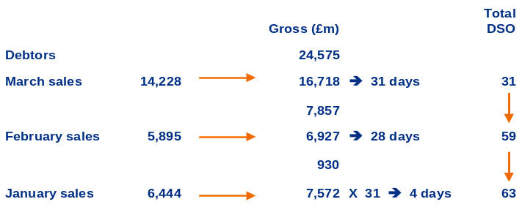
Appendix Two
Calculation of debtors days using count back method
£
Annual Turnover | 76,125
Trade debtors @ 31 March | 24,575
Sales (excl VAT):
March | 14,228
February | 5,895
January | 6,444
  It should not be: DEBTORS x 365 = 24,575 x 365 = 118 days
  SALES 76,125
  as sales tax is included in debtors but not in sales
  Nor is it: DEBTORS x 365 = 24,575 x 365 = 100 days
  GROSS SALES 76,125 x sales tax
  (say 17.5% UK VAT)
  as although you have a consistent numerator and denominator, this does not take account of seasonality.
  Where possible it should be calculated on a countback method as follows:
Countback methods
Gross (£m)
Total DSO
Debtors
24,575
March sales
14,228
16,718
31 days
31
7,857
February sales
5,895
6,927
28 days
59
930
January sales
6,444
7,572
x31
4 days
63

Slide 20
Appendix Three
Illustrative benchmarking

Slide 21
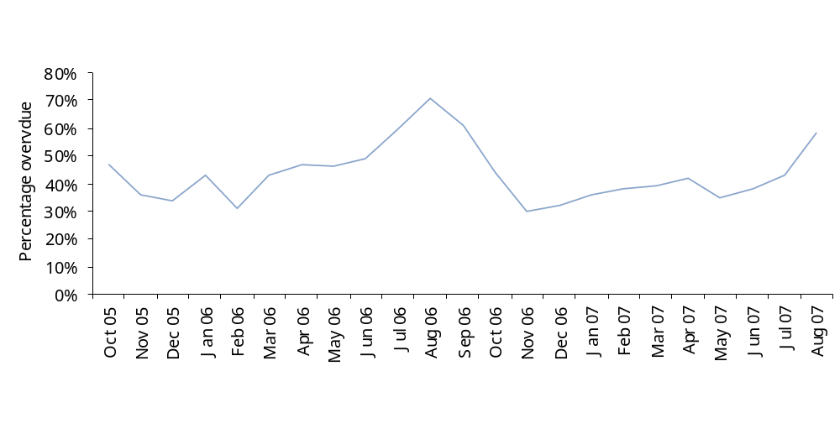
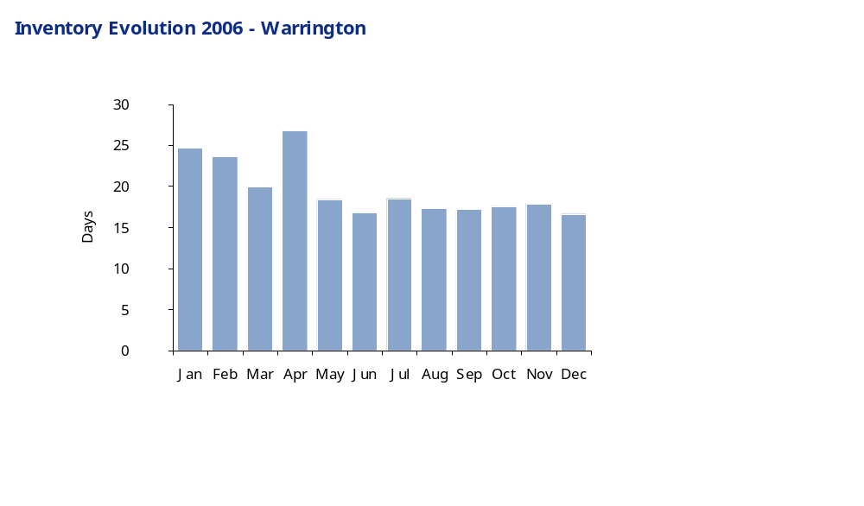
Appendix Three
Time based benchmarking
Sales ledger evolution based on time
Highest level
71%
Current level
58%
Lowest level
30%
Inventory evolution 2006
Max DIO: 27
Min DIO: 17
Median 24.7 days
Average
20 days
Upper quartile 10.7 days

Slide 22
Appendix Three
Internal benchmarking
Internal benchmarking
 | Subsidiary 1 |  |  | Subsidiary 2 | Subsidiary 3 | Subsidiary 4 | Subsidiary 5
 | 2003/04 | 2004/05 | 2005/06
Stock days (number of days) | 45.5 | 65.2 | 76.3 | 34.6 | 43.4 | 49.8 | 56.4
Debtor days (number of days) | 61.1 | 63.4 | 72.2 | 58.7 | 54.5 | 63.5 | 59.8
Creditor days (number of days) | 34.1 | 36.0 | 34.5 | 28.4 | 48.0 | 47.4 | 43.6
Cash (£m) | 465 | 561 | 842 | 1,325 | 91 | 212 | 96
Revenue per employee (£000) | 125 | 153 | 164 | 151 | 90 | 161 | 156
Source: Most recent statutory and management accounts for each entity.

Slide 23
Appendix Three
Competitor benchmarking
Competitor benchmarking
 | Sigma |  |  | Competitor 1 | Competitor 2 | Competitor 3 | Competitor 4
 | 2003/04 | 2004/05 | 2005/06
Stock days (number of days) | 19.1 | 13.4 | 13.4 | 13.5 | 12.0 | 17.5 | 25.4
Creditor days (number of days) | 34.1 | 36.0 | 34.5 | 28.4 | 48.0 | 47.4 | 43.6
Cash (£m) | 465 | 561 | 842 | 1,325 | 91 | 212 | 96
Land and buildings (£m) | 5,845 | 5,294 | 5,448 | 13,748 | 5,853 | 4,929 | 551
Revenue per employee (£000) | 125 | 153 | 164 | 151 | 90 | 161 | 156
Source: Most recent statutory accounts for each entity.

Slide 24
Appendix Four
Example good practice reporting and controls

Slide 25
Appendix Four
Attributes of insightful management information
Objective | Critical Success Factors | Benefits
Management reporting should focus on a balanced set of measures linked to strategic objectives | Understand and articulate the organisational strategy Identify measures that are linked to financial and strategic objectives Get the right balance of ‘financial and non financial’ measures of performance Measures should be both forward and backward looking Each measure should have a performance target | Clear understanding of the key drivers of strategy Clear understanding on performance against strategic objectives Clear alignment between common objectives across the organisation
Measures should be clearly defined and collected in a consistent manner across the whole group | Definition templates should exist for all measures Data definitions should be cascaded throughout the group but centrally controlled Data should be collected in a consistent manner | All measures are can be consolidated efficiently Clear understanding of performance against each measure at group level
Reporting should allow management to focus on key issues, risks and opportunities | Trend analysis and exception reporting will allow for greater focus Analysis of the current run rate will help identify potential performance gaps Focus on the external environment and not just internal performance Include insightful commentaries focused on explaining performance and actions to address the issues | Board and executive committee meetings are focused on ‘managing the future’ and not ‘explaining the past’ External opportunities are understood, evaluated and acted upon
Management information should measure performance against budgets and forecasts | Reporting, forecasting and budgeting should be part of a single integrated process Management reporting should not be tied to the 12 month financial calendar Rolling forecasts will provide continuous insight beyond the current financial year | Engenders a forward looking culture Rolling 12 month forecasts can support the following years budgeting process
Management information should be supported by robust and efficient processes | Maximise the automation of your reporting processes including submissions Minimise the number of requests for ad-hoc reports Establish a clear timetable and processes for submitting information based around the user meetings | Supports the quality close process Responsibilities and expectations are clear and well understood
Presentation and analysis should reflect organisational structures, responsibilities and accountabilities | Organisational structures, responsibilities and accountabilities should be clearly understood Measures and analysis of information should have owners with clear lines of responsibility and accountability | Performance is viewed in a consistent way as accountabilities

Slide 26
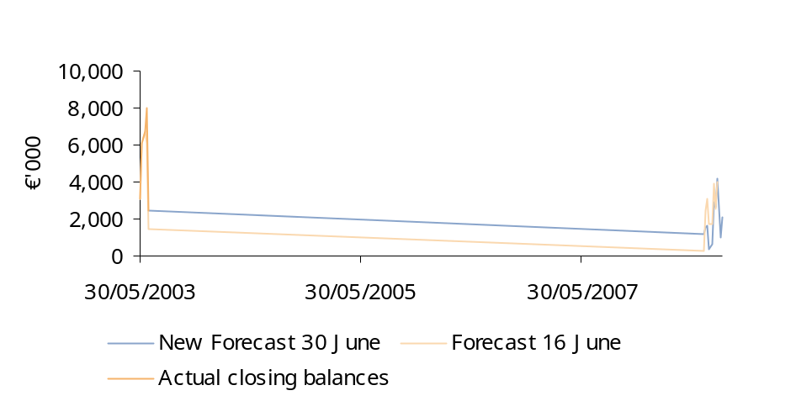
Appendix Four
Example – reporting of cash and working capital
Example
Suggested contents
  High level overview commentary
  Graphical development of cash actuals, base forecast(s) and revised forecast (as illustrated opposite)
  Narrative regarding new and previous forecast variances (as illustrated opposite)
  Summary waterfall of components of new forecast
  Summary variance analysis and narrative explanation of key variances
  Key forecast assumptions – should not need re-drafting each iteration
  Comment on large or unusual items
Other
  Summary of cash balances
    Locally held – highlighting any trapped cash balance
    Notional – including central inter-company balances
  Key risks and sensitivities
Source: […]
Example
€’000 | Actual | Forecast | Variance | Comment
Debtor collections | 6,267 | 12,091 | 5,824
New sales | - | - | -
Intercompany receipts Int | - | - | -
I/c receipts Others | 216 | - | (216)
Other operating inflow | - | - | -
Trading payments | (7,495) | (12,663) | (5,168)
New purchases | - | - | -
Corporation tax | 21 | - | (21)
I/co payments Int | - | - | -
I/co payments Others | - | - | -
Other operating outflows | (552) | (822) | (270)
Cash from op'ing activities | (1,543) | (1,394) | 149
Source: […]

Slide 27
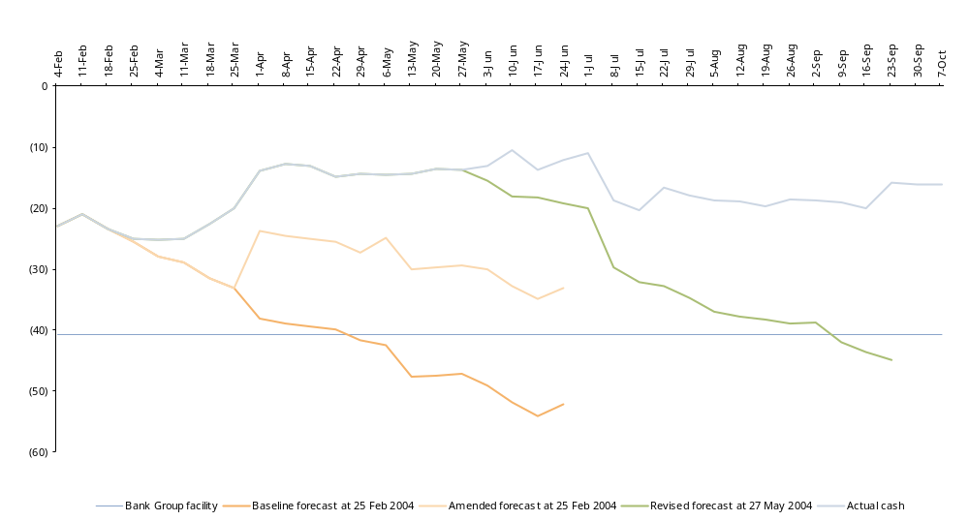
Appendix Four
Cash flow monitoring – example graphical representation
  This example can be used (separately) for both the short and long term cash flow forecasting with new lines added at each reforecast interval (i.e. monthly for the short term, quarterly for the long term).
At 20 May an improvement of £17m from the base line forecast
At 23 September an improvement of £29m from the 27 May 2003 forecast
£m
Forecast facility breach

Slide 28
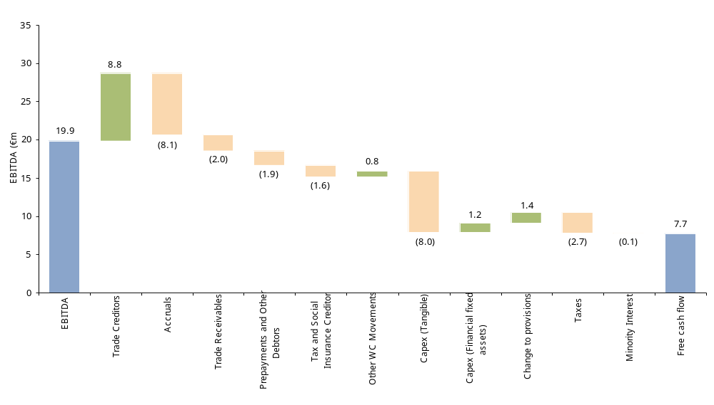
Appendix Four
Example – EBITDA to Free Cash Flow Reconciliation
Total increase in WC of €4 million
Reclassification of intercompany balances at point of acquisition
Relates to revaluation of property (non-cash)
Includes repayment of £7.0 million loan from Telegraaf
2004/05 tax settlement

Slide 29
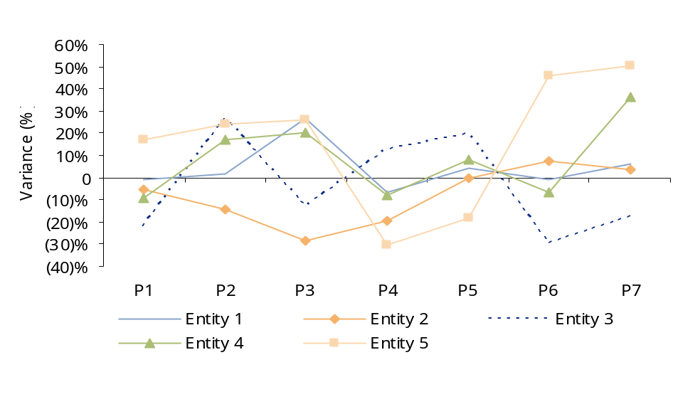
Appendix Four
Example reporting contents – accuracy of forecasting
Monthly variance of cash flow in the long term cash flow forecast as a percentage of turnover (%)
Forecast accuracy
% | Cumulative variance as a percentage of turnover | Cumulative variance as a percentage of forecasted cashflow
Entity 1 | 12% | 44%
Entity 2 | 8% | 64%
Entity 3 | 20% | 72%
Entity4 | 32% | 89%
Entity 5 | 16% | 111%
Note: The ranking has been based on absolute monthly cumulative variances (to XXX) as a percentage of the budgeted/forecasted cash and turnover. Source: Cash flow variance report.
Sources of variance
Ranking | Entity 1 | Entity 2 | Entity 3 | Entity 4 | Entity 5
1 | Creditors | Creditors | Creditors | Creditors | Creditors
2 | Stock | Stock | Stock | Stock | Capex
3 | Debtors | Debtors | Debtors | Debtors | Debtors
4 | Capex | Capex | Capex | Capex | Stock
5 | Operating profit | Sale of assets | Operating profit | Operating profit | Payments for investments
Note: Ranking based on an absolute basis and not as a percentage of underlying balance. Source: Cash flow variance report.
Source: Cash flow variance report, management information.
  The main causes of variances are within working capital and capital expenditure. There are no specific patterns in the variances.
  Example comment
  A review of the accuracy of the long term cash flow forecasts produced since the start of the financial year has shown a high degree of variance between actual and budget or latest forecast positions.
  The actual cash balance does not consistently out-perform or under-perform the forecast which indicates general inaccuracy rather than consistently prudent or aggressive assumptions.

Slide 30
Appendix Four
Example output - Cash reporting and controls
Area | Potential areas of focus
Cash KPIs | Net working capital reported monthly by division. EBITDA to operating cash. Unbilled work/lock-up. Debtors ageing analysis and exception reporting. Trade creditor days monitoring, with customer prepayments stripped out from the calculation. Review of rental assets to identify forecast utilisation based on sales forecast.
Forecasting | Short term cash forecast (STCF) reflecting unwind of debtors/creditors ledgers – receipts and payments basis. Very important given the potentially 'lumpy' nature of cash flows. Integrated long term forecast. Detailed operating cash cycle with action plans to deliver improvements, monitored against KPIs. Monitoring and variance investigation – embed savings to STCF. Focused cash committee to drive implementation of initiative.
Controls | Consistent terms of trade for customers and suppliers across the Group. Cash payment processes (time, frequency). Contract evaluation - cash versus profit. Standardised and pro-active credit control processes (e.g. dunning letters, legal, on-stop, service withdrawal). Capex evaluation – payback period.

